Slide 1


Analytics in Fundraising
Group 1:
Théau Bruno, Laura El Aoufir,
Thomas Henry, Noémie Gautier

Slide 2
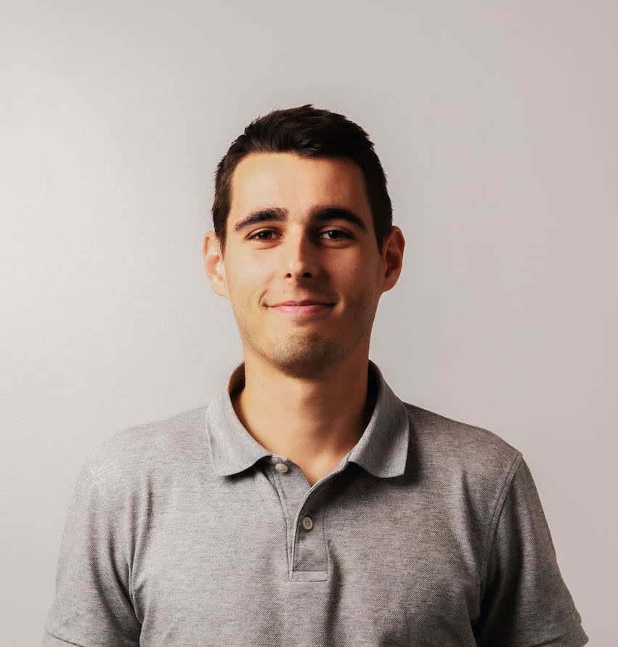
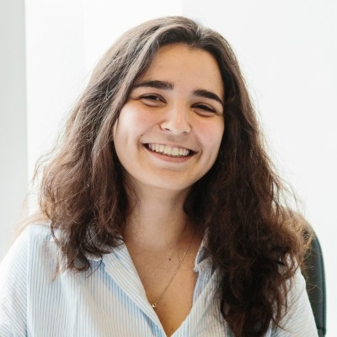
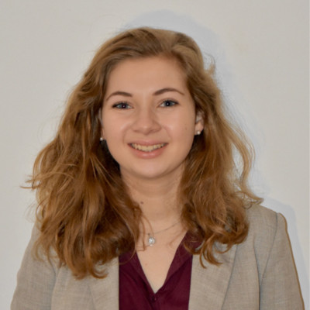
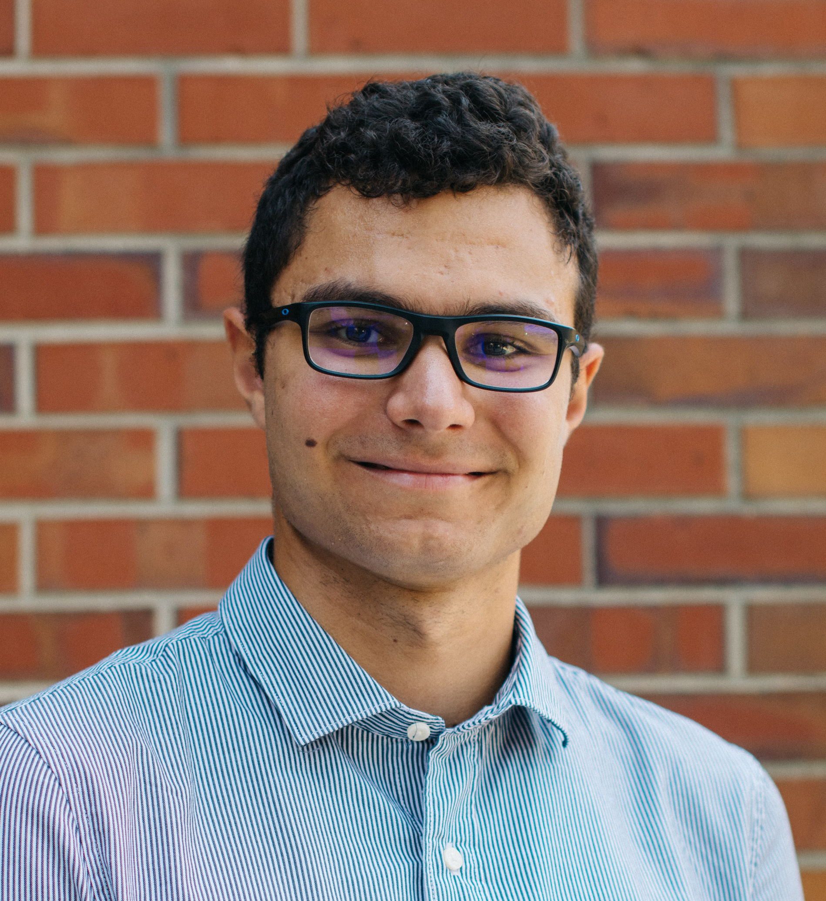
OUR TEAM:
Théau Bruno
Laura
El Aoufir
Noémie Gautier
Thomas Henry

Slide 3
01
02
03
04
Project DEFINITION
OUR MODEL
MODEL EVALUATION
Conclusion

Slide 4
01. Project Definition

Slide 5
ABOUT THE PROJECT
Create a predictive model based on past fundraising campaigns to select the best candidates for your new fundraising campaign.
Notes:
Should we detail what we did briefly?

Slide 6
TIMELINE
Campaign 6169
CAMPAIGN 7244
Future Campaign
Launched on: 04/09/2018
Time Gap: 2 days
Average response time: 10 days
Features: all past data prior to the launch date of the campaign
Training set
Launched on: 18/06/2019
Time Gap: 2 days
Average response time: 11 days
Features : all past data prior to the launch date of the campaign
Test set
Features: all past data prior to the launch date of the campaign
Time Gap: estimated 2 days
Notes:
We decided to take all to make it more accuracy of the data but we can take less if that data is deleted.
We used the past data, time gap and the time of the campaign results in the next few months.
Takes about a month to get all the answers.

Slide 7
02. our model

Slide 8
What WE did
Step 1:
Cleaned tables
Created Train test based on campaign 6169
Created Test set based on campaign 7244
Created features
Tested 78 features
Selected the 24 features that were relevant
Step 2:
STEP 3:
Tested the accuracy
Compared different algorithms
STEP 4:
Chose Boosted Gradient Tree Algorithm
Use model to calculate probabilities
STEP 5:
Created various graphs
Gathered Insights

Slide 9
Key features:
Personal data
Amount Features
Age
Gender
Previous donation Amount
Time features
Frequency of general donation
Time of the year
Time since the last donation
Time and amount of the last 3 donations

Slide 10
KEY INSIGHTS
CALENDAR
Gender
AGE count
December and January
+80% donation
+48% females
40-50 years
25% of donations
Frequency
AGE amount
Time to get Donations
80% of donors
gave within 3 years
9% of donor give 2 time a year
Senior
&
20-30 years old
70% of donation
<70 euros

Slide 11
BEST DONORS
Old or young Female
In their 20S or Over 80
AGE
Female
GENDER
Good average Frequency
Frequency of Donation
Donated in the Past Year
Type of DONOR
Notes:
Currently your target donors are:
Women
Over 60
No children at home
Religious

Slide 12
03. EVALUATING our model

Slide 13
Currently the average response rate for your campaigns is 1.8%
How can we maximize the profit?

Slide 14
PAST CAMPAINGS
Campaign 6169 -04/09/2018
Campaign 7244 - 18/06/2019
34 888 people contacted
1 991 responded
3.4 % Response Rate
Funding gathered : 98 653 €
Costs: 30 352 €
Benefit: 63 301€
25 000 people contacted
361 responded
1.4 % Response Rate
Funding gathered : 18 616 €
Costs: 14 104€
Benefit: 4 511€
Notes:
Getting the response rate is good but we also need to look at how much people who answered gave.
Where the two campaigns provided successful?
In first campaign someone gave over 1000 euros which is rare so we

Slide 15
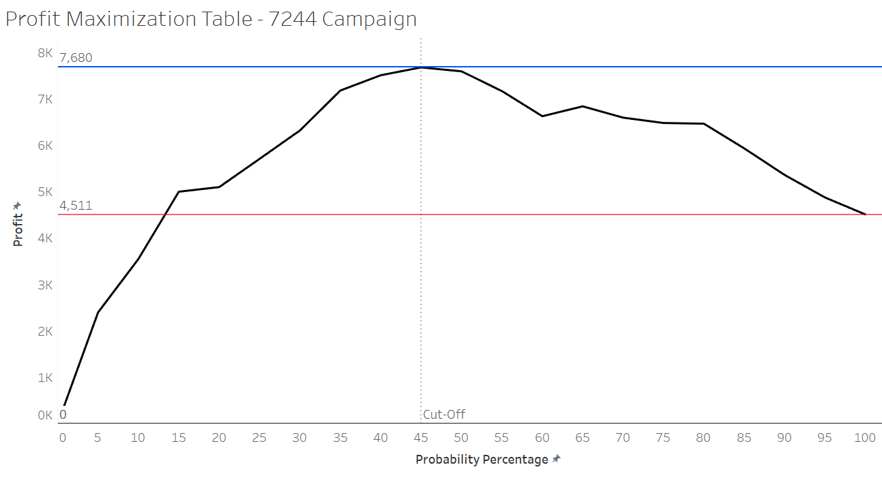
Maximizing Profit:

Slide 16
Campaign 7244- WITH OUR MODEL
11 540 people contacted
254 responses
2.2% Response Rate
Funding gathered : 14 027€
Costs: 7 052€
Benefit: 7 680€
→ +70 % of benefits

Slide 17
OUR STRATEGY PROPOSITION:
Target Population:
TOP 10 donors:
Donors that have the highest probability of donating
In campaign 7244: over 45% we start losing money
WHO: People who in the past have given the biggest amounts
STRATEGY: Could call them instead of sending them letter
BUT: make sure to not call or contact them too much

Slide 18
04. CONCLUSION

Slide 19
PROJECT STAGES
Step 1:
Built the model for you to use
Step 2:
Use the model for your next campaign
STEP 3:
Re-evaluate the model once we have the results of the campaign (takes approximately a month)

Slide 20
OUR CONCLUSION
Our MODEL
ADVANTAGES OF OUR MODEL
CAMPAIGN 7244
Calculation of the probability that donors will donate in the next campaign
Priority list of clients
Maximisation of profit
Reduction in costs
With the data known we could have increased the benefits by 70%
DONORS
GETTING MORE DATA
There are also a lot of donors with a low probability to donate
Could collect additional data in the next campaign to get more features and a more specific model

Slide 21
Thank YOU
Any Questions?

